Slide 1
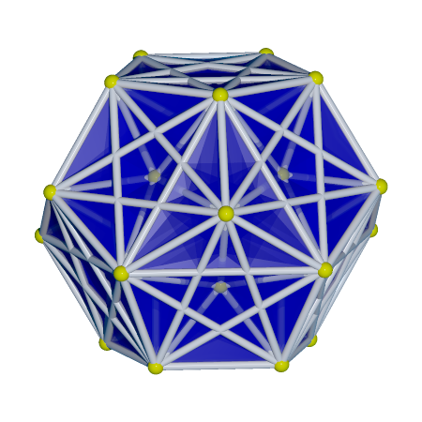
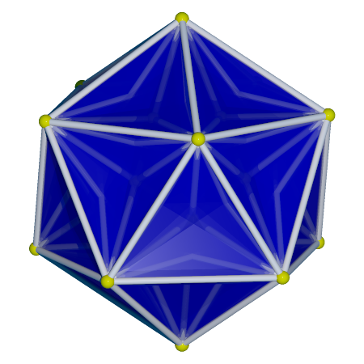
3₂₁ polytope
E7 symmetry
Semi-regular polytope in R⁷
Projected to 3D. Shadow may have icosahedral symmetry

Slide 2
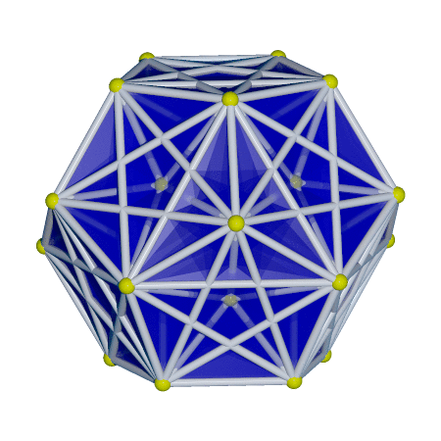
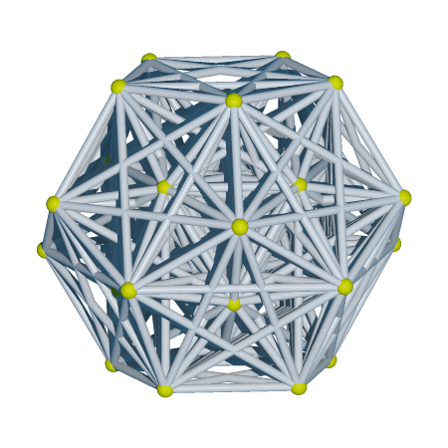
Rotate in 7D

Slide 3
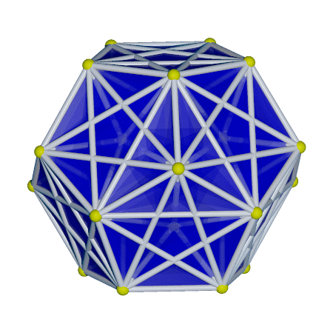
Other ways of rotation
- Shadow: also between the regular dodecahedron and icosahedron
- Regular icosahedral shadow achieves the largest 3D volume

Slide 4
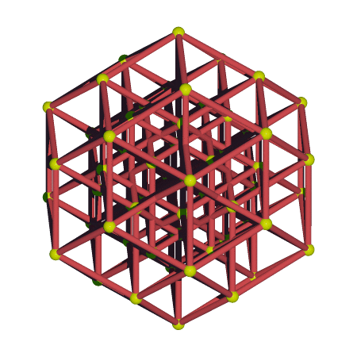
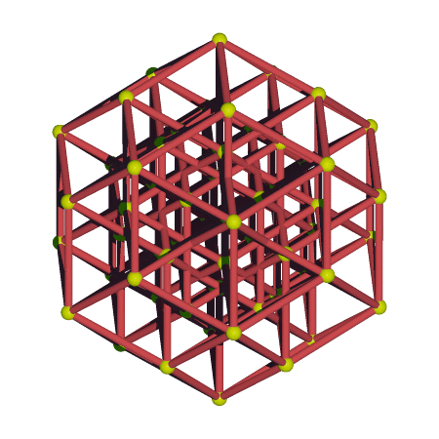
This projection is related to the 6D -> 3D projection that projects the
6-cube to a rhombic 30-hedron. See 3D print.

Slide 5
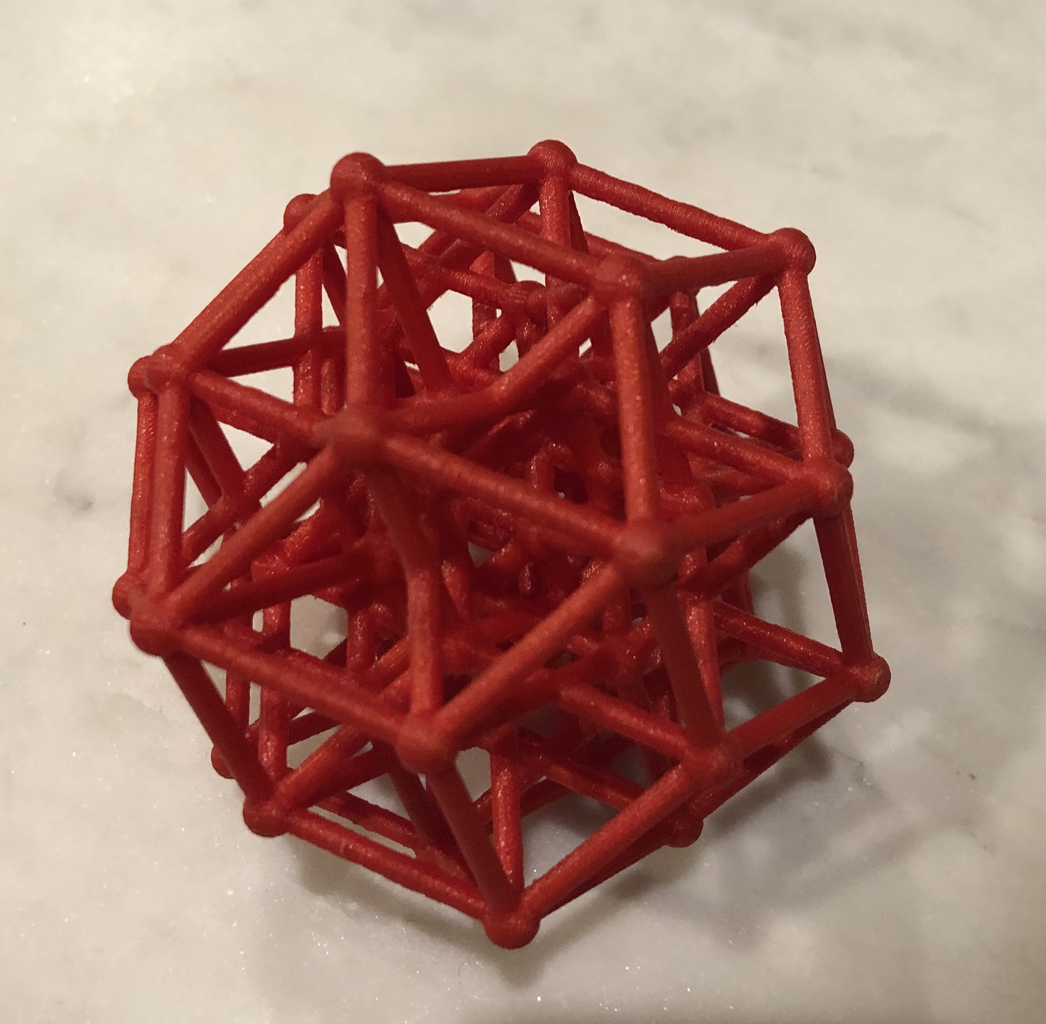
3D printed 6-cube projected to 3D

Slide 6
Images and source code in
https://github.com/nanma80/gosset
Questions about the projection from 7D and 6D?

